Slide 1
程式設計實習(一)

Slide 2
struct
struct Book
{
char title[80];
char author[80];
char publisher[80];
int year;
};
Book novels[3];
novels[0]
AAA | John | Faber | 1993
novels[1]
BBB | Peter | Hodder | 1982
novels[2]
CCC | Terry | Victor | 1978

Slide 3
struct
…
int main()
{
Book novels[3];
for( int i = 0; i < 3; i++ )
{
cout << " title: “;
cin >> novels[i].title;
cout << " author: ";
cin >> novels[i].author;
cout << " publisher: ";
cin >> novels[i].publisher;
cout << " year: ";
cin >> novels[i].year;
cout << endl;
}
…
}

Slide 4
File Read & Write
#include <fstream>
ifstream inFile( "test.txt", ios::in );
Open an existing file; if the file doesn't exit, fail.
ofstream outFile( "test.txt", ios::out );
Create a file; if the file have existed, the data in it will be deleted.
ofstream outFile( "test.txt", ios::app );
Create a file; if the file have existed, the data in it will be keep.

Slide 5
File Read & Write
struct score
{
  char name[4];
  int calculus;
};
score grade;
ifstream inFile( "test.txt", ios::in );
inFile >> grade.name >> grade.calculus;
inFile.close()

Slide 6
File Read & Write
struct score {
char name[4];
int calculus;
};
score grade[2] = { “Joy", 100, “Ken", 35 };
ofstream outFile( "成績.txt", ios::out );
outFile << grade[0].name << " " << grade[0].calculus << endl;
outFile << grade[1].name << " " << grade[1].calculus << endl;
outFile.close()

Slide 7
Hw 12
Input
User can enter the new data in file.
Output
Show scores of all students.
(學期成績 = coursework*0.3 + midTerm*0.3 + finalTerm*0.4)
Need two functions.

Slide 8
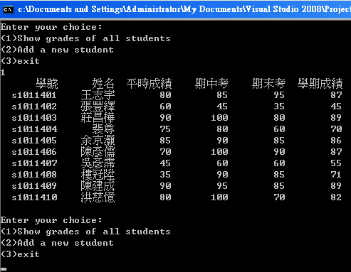
Hw 8

Slide 9
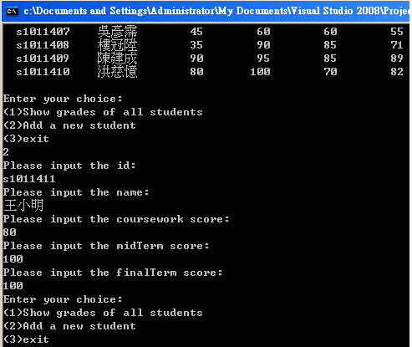
Hw 8

Slide 10
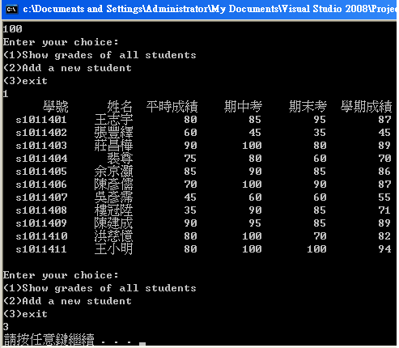
Hw 8

